Slide 1

Advances in Computer Vision and Image/Video Processing
A Short-term course on
February 26 – March 7, 2024
Tushar Shinde

Slide 2
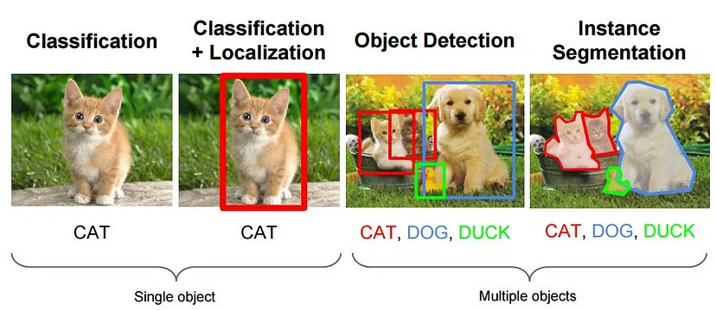
Introduction to Computer Vision and Image/Video Processing
The course began with an introduction to computer vision, covering basic principles, terminology, and applications. Participants learn about the importance of computer vision in various domains, such as healthcare, autonomous vehicles, surveillance, and augmented reality.
https://towardsdatascience.com/everything-you-ever-wanted-to-know-about-computer-vision-heres-a-look-why-it-s-so-awesome-e8a58dfb641e

Slide 3
Topics covered
What is computer vision (CV)?
What is driving CV?
Basics of Image/Video processing
What is Image?
Types of Images
OpenCV
Basic image processing operations using OpenCV and Python
Standard Test Images Dataset: https://www.imageprocessingplace.com/root_files_V3/image_databases.htm

Slide 4
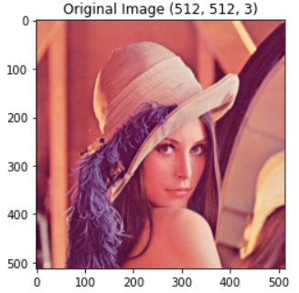
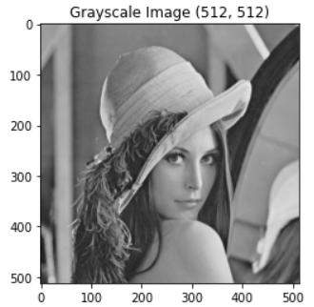
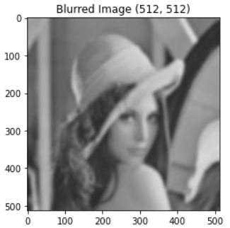
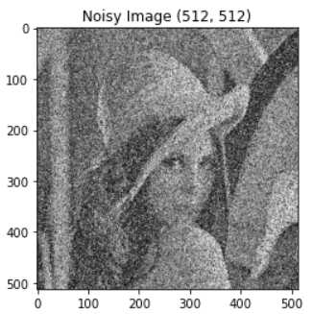
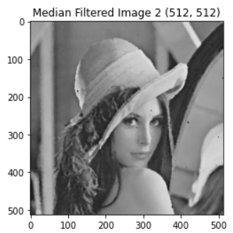
Image/Video Filtering and Super-resolution
Participants delve into image and video filtering techniques, including linear and non-linear filters, edge-preserving filters, and super-resolution methods. They understand how these techniques enhance image quality, remove noise, and improve resolution.

Slide 5
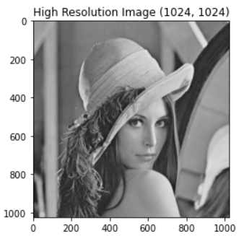

Topics covered
Smoothing filters
Sharpening filters
Edge detection filters: Sobel, Prewitt, Canny
Morphological filters
Video filtering
Image Super-resolution: SISR, MISR
Video Super-resolution: SFVSR, MFVSR
Applications

Slide 6
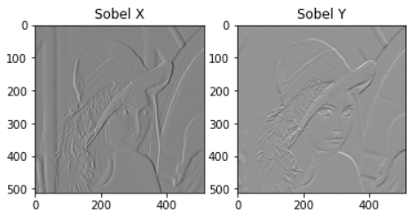
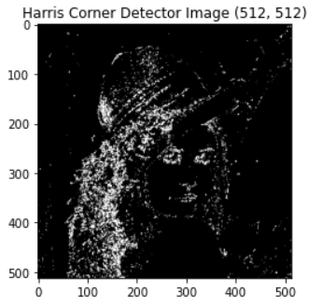
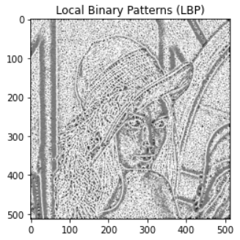
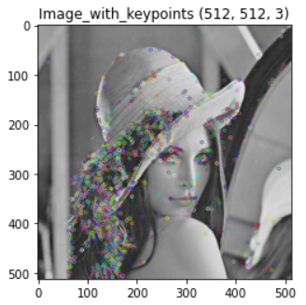
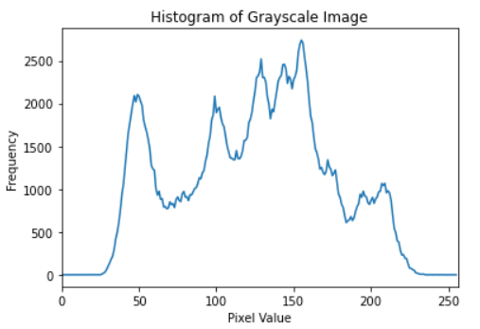
Image Features and Classification using AI/ML
This module focuses on feature extraction and image classification using artificial intelligence and machine learning algorithms. Participants learn about popular feature descriptors, such as Histogram of Oriented Gradients (HOG), Scale-Invariant Feature Transform (SIFT), and Convolutional Neural Networks (CNNs).

Slide 7
Topics covered
Image Feature extraction
Traditional Methods:
Histogram of Oriented Gradients (HOG),
Scale-Invariant Feature Transform (SIFT),
Speeded-Up Robust Features (SURF), and
Local Binary Patterns (LBP).
Deep Learning-based Methods: CNN
Feature Representation
Machine Learning Model Training
Image Classification
Evaluation and Validation
Deployment, Testing, and feedback

Slide 8
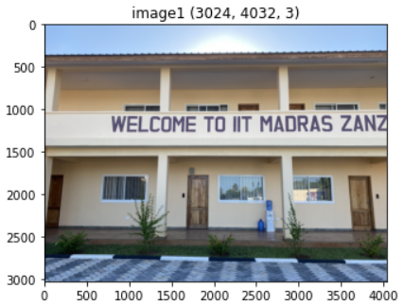
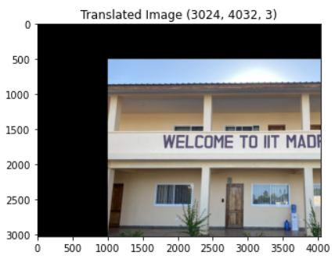
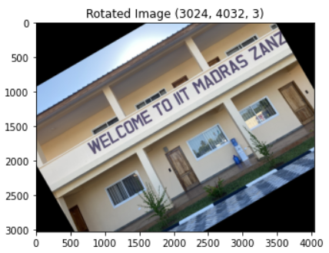
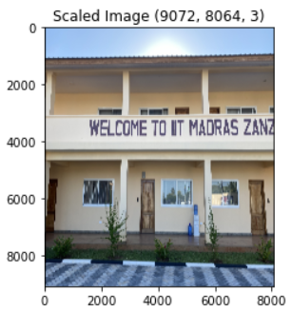
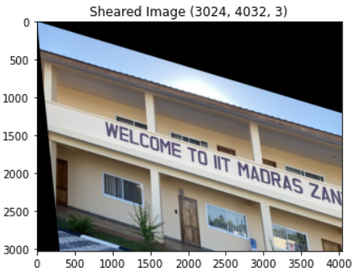
Image Transformation and Registration Techniques
Participants explore image registration techniques for aligning images from different sources or modalities. They learn about geometric transformations, point-based and intensity-based registration methods, and their applications in medical imaging, remote sensing, and computer-aided design.

Slide 9
Topics covered
Image transformation:
Translation
Rotation
Scaling
Shearing
Affine
Perspective
Image registration:
Intensity-based registration
Feature-based registration
Applications

Slide 10
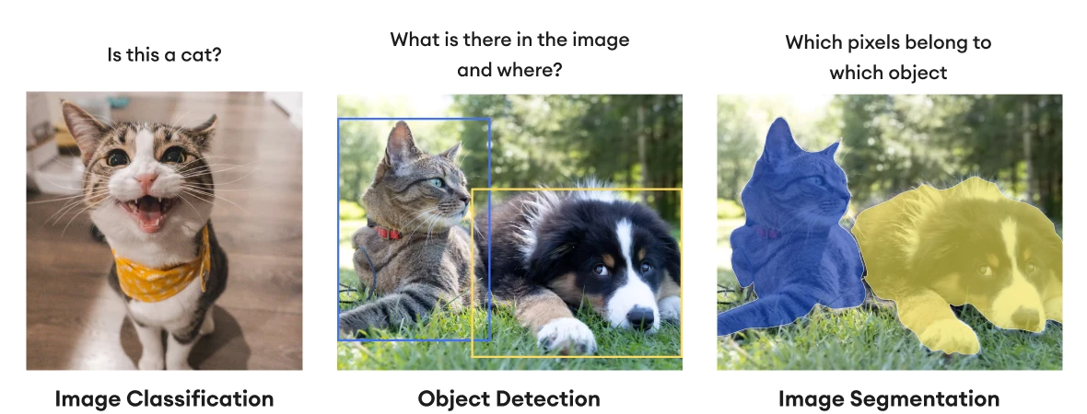
Image/Video Segmentation
This module covers image and video segmentation algorithms for partitioning visual data into meaningful regions. Participants learn about thresholding, region-based segmentation, contour-based segmentation, and deep learning-based segmentation approaches.
https://www.superannotate.com/blog/image-segmentation-for-machine-learning

Slide 11
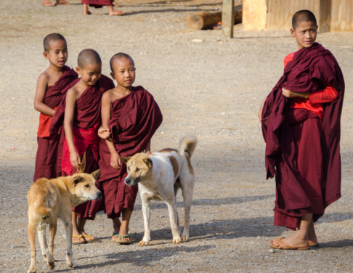
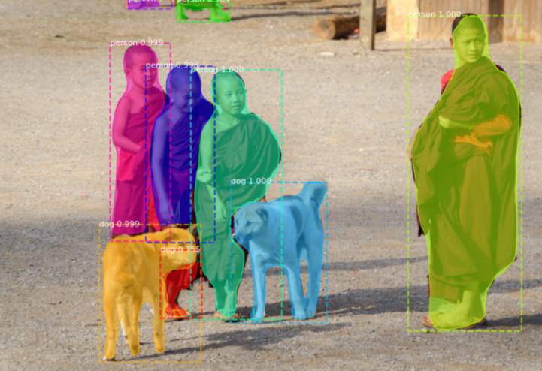
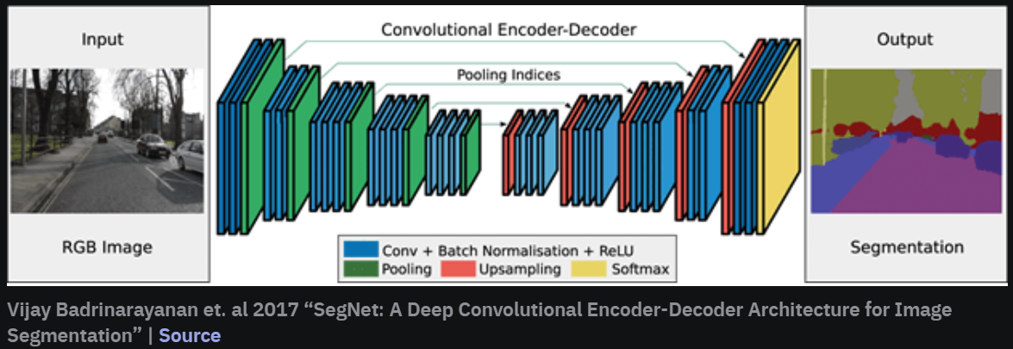
Topics covered
Image/video segmentation
Image segmentation types
Binary segmentation
Otsu’s thresholding
Region-based Segmentation
Edge-based Segmentation
Semantic and Instance segmentation
Video segmentation
https://neptune.ai/blog/image-segmentation

Slide 12
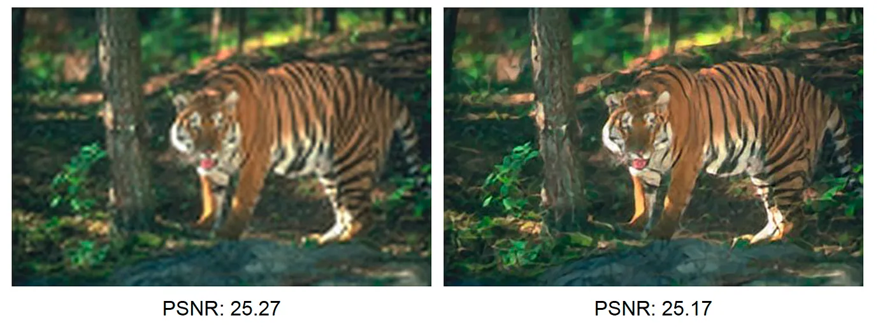
Image/Video Quality Assessment
Participants study methods for assessing the quality of images and videos objectively. They learn about popular quality metrics, such as the Peak Signal-to-Noise Ratio (PSNR), Structural Similarity Index (SSIM), and Video Multimethod Assessment Fusion (VMAF).
https://towardsdatascience.com/deep-image-quality-assessment-30ad71641fac

Slide 13
Topics covered
Image/Video Quality Assessment
Subjective
Objective
MOS
Objective IQA metrics include:
Mean Squared Error (MSE),
Peak Signal-to-Noise Ratio (PSNR),
Structural Similarity Index (SSIM),
Multi-Scale Structural Similarity (MS-SSIM), and
Visual Information Fidelity (VIF).
Objective VQA metrics include:
Video Quality Metric (VQM),
Structural Similarity Index for Video (SSIMV),
Video Multimethod Assessment Fusion (VMAF)
Correlation: Pearson, Spearman, Kendall

Slide 14
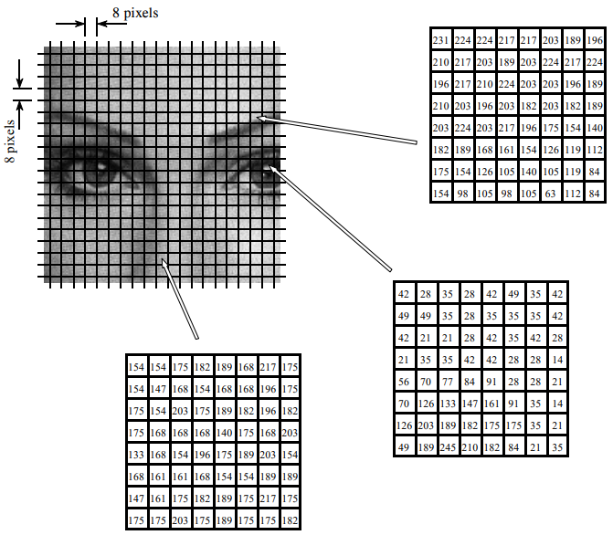
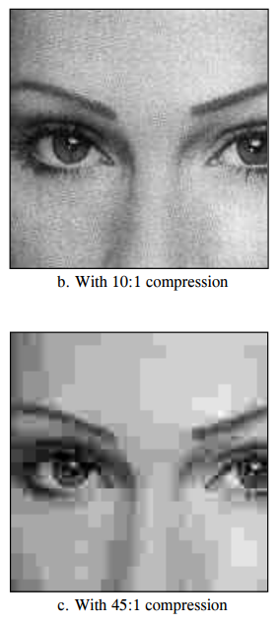
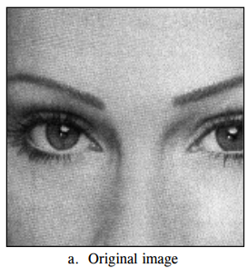
Motion Estimation and Advances in Image/Video Compression
Participants explore motion estimation techniques for analyzing temporal information in video sequences. They also learn about recent advances in image and video compression algorithms for efficient storage and transmission.
https://www.analog.com/media/en/technical-documentation/dsp-book/dsp_book_Ch27.pdf

Slide 15
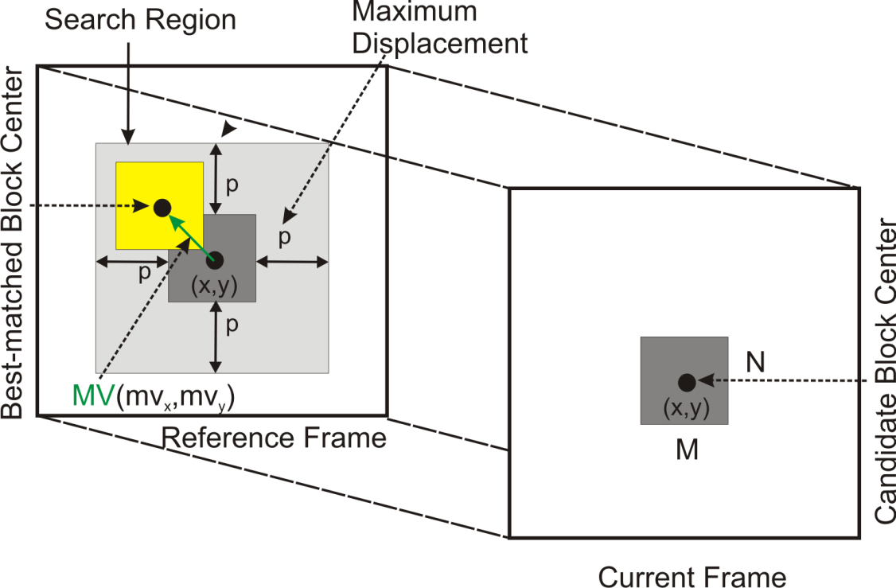
Topics covered
Data compression
Lossless
Lossy
Entropy coding
Huffman
Arithmetic
RLE
Image compression
Video compression

Slide 16
Future Scope and Career Opportunities
The field of computer vision and image/video processing offers abundant career opportunities in various industries, including healthcare, automotive, entertainment, and security.
One can pursue careers as a computer vision engineer, image processing specialist, data scientist, research scientist, and software developer.
They can work on exciting projects such as developing autonomous vehicles, creating medical imaging systems, designing augmented reality applications, and enhancing video surveillance systems.
With the increasing demand for automation and intelligent systems, professionals with expertise in computer vision are highly sought after by leading tech companies, research institutions, and startups.
Moreover, the interdisciplinary nature of computer vision opens up avenues for collaboration with experts in fields like robotics, natural language processing, and human-computer interaction.

Slide 17

conclusion
Overall, we hope that the short-term course provided a solid foundation for individuals aspiring to embark on a rewarding career in computer vision and image/video processing, offering them the necessary skills and knowledge to thrive in this dynamic and rapidly evolving field.
Thank you

